Slide 1

RED CELL NETWORK
Bachelors of Technology
in
Computer Science &Engineering (2025)
Presented by
Aman Singh(2101220100016)
Alok Kumar(2101220100015)
Under the guidance
of
Er.Shubham kumar

Slide 2

INTRODUCTION
The project is known to be a Red Cell Network that is designed for the blood bank to gather blood from various sources and distribute it to the needy people who have high requirements for it.
The software is designed to handle the daily transactions of the blood bank and search the details when required.
It also helps to register the details of donors, blood collection details as well as blood issued reports.
The software application is designed in such a manner that it can suit the needs of all the blood bank requirements in the course of future.

Slide 3


EXISTING SYSTEM
The operation of the blood bank still now is maintained in the manual system.
The operation is tedious, time consuming and space consuming.
It creates room for errors as the data is entered manually by the persons.
It includes the risk of the documents being lost over years and maintenance of the records is difficult.
Maintaining the stock of blood and the daily transactions without computerisation also poses a challenge.

Slide 4

PROBLEM DEFINITION
Scarcity of rare blood group unavailability of blood during emergency.
Less awareness among people about blood donation and blood transfusion and deaths due to lack of blood during operations..
The Blood Bank Management System project aims to make all the procedures automated and therefore with computer system it can be more fast and accurate.
This project is a high quality software to manage all these cumbersome jobs.
Limited Donor Engagement and Emergency preparedness the current system lacks a proactive approach to engage potential donors for future emergencies.

Slide 5

OBJECTIVES
Adaptability and Scalability: Ensure easy integration with existing hospital management systems and blood bank networks.
Rapid Emergency Response: Provide immediate and swift response to emergency calls to ensure timely arrival at the scene of incidents.
Emergency Preparedness and Rapid Response:Establish a mechanism for quick and efficient responses to emergency blood requirements.
Data Security and Privacy: Incorporate robust security measures to protect sensitive donor and patient information.
Enhanced Blood Donation Process: Implement a user-friendly interface for donors, making the blood donation process transparent, accessible, and convenient.

Slide 6

PROPOSED METHODOLOGY
User Registration: Donors, recipients, and hospitals sign up online.
Blood Requests: Recipients request blood, and the system finds
the nearest available units.
Donor Management: Tracks donors and sends reminders for the next donation.
Inventory Management: Monitors blood stock and ensures no wastage.
Emergency Alerts: Sends notifications to nearby donors during emergencies.
Data Security: Protects sensitive information with encryption.
Web Access: Users can access the system anytime through web or mobile.

Slide 7

TECHNOLOGY USED
1.Frontend:
• HTML: For the structure of the web pages.
• CSS: To style the pages and make them visually appealing.
• JavaScript: To make the website interactive and responsive.
2.Backend:
• Python: The main programming language used for server-side logic.
•Django: A web framework built in Python to handle user requests, manage data, and control the backend.
• SQLite3: A lightweight database for storing data like donor info, blood stocks, and requests.
3.Security:
• SSL/TLS Encryption: To ensure secure communication between users and the server, protecting sensitive data.
• OAuth2.0: For secure user authentication and authorization.

Slide 8
SOFTWARE/HARDWARE REQUIRED
SOFTWARE REQUIRMENTS
Operating System: Windows, Linux, or macOS.
Programming Language: Python for backend development.
Framework: Django (Python-based web framework) to handle server logic and connect with the database.
Database: SQLite3 for storing donor, recipient, and blood stock data.
Web Technologies: HTML, CSS, JavaScript for the front-end user interface.
Development Tools:
Visual Studio Code: For writing and debugging code.
Browser Support: Google Chrome, Mozilla Firefox, or any modern browser for accessing the web application.

Slide 9

HARDWARE REQUIRMENTS
Minimum Disk Space: 350 MB for installation.
System Memory (RAM): At least 1 GB for the server, 4 GB recommended
for smooth operation.
Processor: Minimum Intel Pentium 4 or higher.
Network Card: Required for internet connectivity.
Hard Disk Space: 4 GB of free space recommended for storing data and
running the system.

Slide 10
MODULE DESCRIPTION
User Module: Manages registration, login, and profiles for donors, hospitals, and recipients.
Blood Request Module: Allows recipients to request blood and find available units.
Donor Module: Tracks donor info and sends donation reminders.
Inventory Module: Manages blood stock, including availability and expiry.
Admin Module: Gives admins control to manage requests, blood stock, and generate reports.
Notification Module: Sends alerts for donations and emergencies via SMS and email.

Slide 11
FEATURES
Easy Registration: Donors and hospitals can quickly sign up and log in.
Secure Data: Keeps all donor and recipient information safe with encryption.
User-Friendly Interface: Simple design that’s easy for anyone to use.
Emergency Alerts: Quickly alerts nearby donors during emergencies.
Quick Blood Requests: Receivers can request blood easily through the system.
Blood Search: Find available blood types and their details.

Slide 12
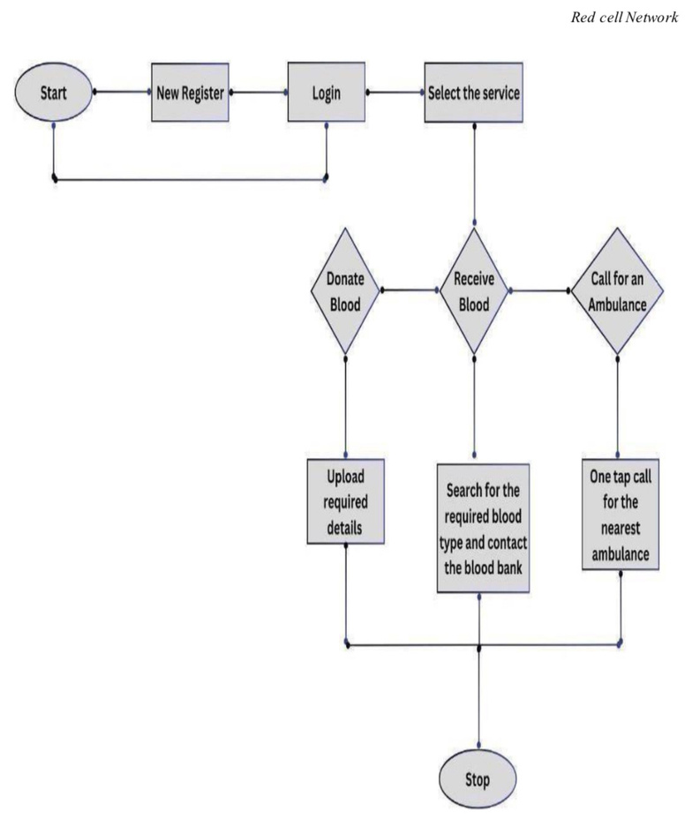
ARCHITECTURE

Slide 13
ADVANTAGES
Accessibility: Online blood bank repositories are accessible 24/7 from anywhere with an internet connection. .
Reduction of paperwork makes it easier for blood banks to manage donor information, blood inventory, and other critical data.
Real-Time Monitoring: Enables instant alerts and proactive management of blood supplies and donor health data.
Cost-effectiveness: leads to cost savings through improved inventory management
and resource allocation
Secure Data Management:Ensures that sensitive donor and recipient information
is protected with encryption and other security protocols.

Slide 14
DISADVANTAGES
Digital Divide: Not everyone has equal access to the internet or the necessary technology to use online blood bank repositories.
Privacy and Security: Concerns: Data breaches or cyberattacks can compromise the confidentiality of registered information.
Internet Dependency: The system relies heavily on internet connectivity, which may be problematic in regions with unstable or unreliable internet access, limiting system availability.
Maintenance Costs: Regular updates and system maintenance are necessary to keep
the system secure and functional, which can increase ongoing operational expenses.
Dependency on Technology: system failures, technical glitches, or power outages can
disrupt blood bank operations and impede access to critical information.

Slide 15
APPLICATIONS
Hospital Blood Banks:It is integrated into hospital systems to manage blood inventories, donor records, and requests for blood units.
Blood Donation Campaigns and Events:Supports outreach efforts to encourage participation and maintain a database of potential donors for future events.
Government Health Departments:It is implemented by government health departments to oversee and regulate blood donation and distribution at a regional or national level.
Public Awareness:Educates the public on blood donation importance, sends alerts for specific blood needs, and promotes drives.
Independent Blood Banks:Used by standalone blood banks to streamline operations, manage donor information, and ensure proper inventory control.

Slide 16
FUTURE SCOPE
Emergency Alerts: Enable: Blood banks to send emergency alerts to nearby donors when there's a shortage or disaster.
End-to-end Encryption: Protect user privacy with secure communication and data storage.
Wearable Device Integration: Integrate health monitoring devices to update donor eligibility in real time.
Multi-Language Support: Provide the system in multiple languages to reach a wider audience
Feedback and Ratings: Allow recipients to rate and provide feedback on donors and blood banks. Build a transparent and trustworthy system for users.

Slide 17
THANKYOU
Presented by
Aman Singh(2101220100016)
Alok Kumar(2101220100015)

